Slide 1
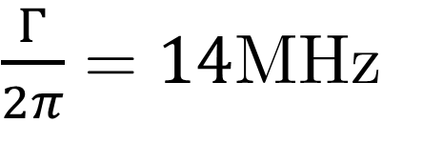
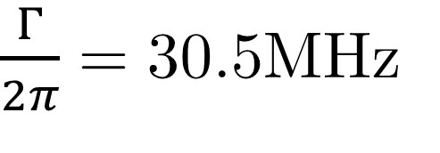
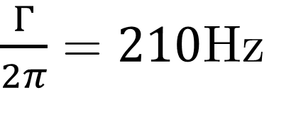
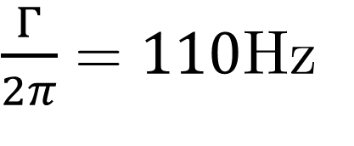
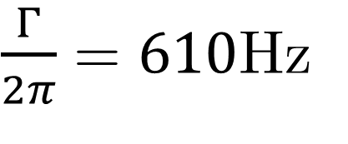
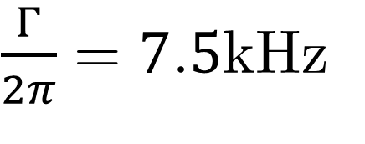
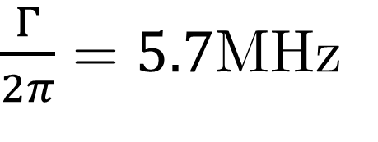
(5p²) ³P₂
(5s5p) ¹P₁
$\frac{Γ}{2π}=610$Hz
$\frac{Γ}{2π}=5.7$MHz
481 nm
$\frac{Γ}{2π}=14$MHz
(5s4d) ¹D₂
$\frac{Γ}{2π}=110$Hz
$\frac{Γ}{2π}=210$Hz
_{j=2}
}
461 nm
_{j=1}
(5s5p) ³P_{j}
$\frac{Γ}{2π}=30.5$MHz
689 nm
_{j=0}
$\frac{Γ}{2π}=7.5$kHz
Driven Transition
(5s²) ¹S₀
Spontaneous Emission

